Slide 1
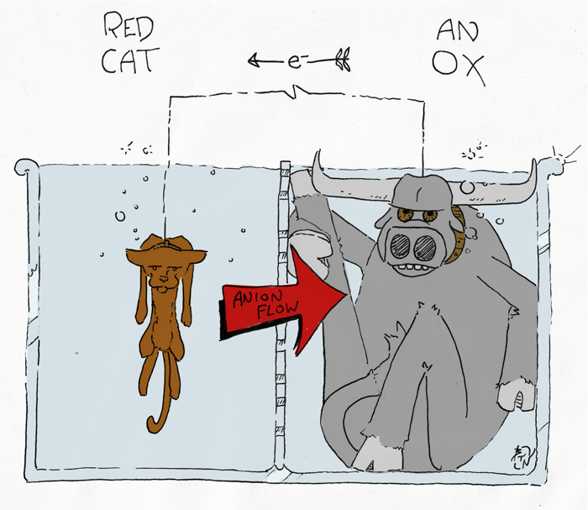
Reduction and Oxidation
Redox chemistry: Introduction
ATAR Chemistry Unit 3 2021
Bret Norwood. http://learning-laboratory.com/redox-reactions-oxidation-reduction/

Slide 2
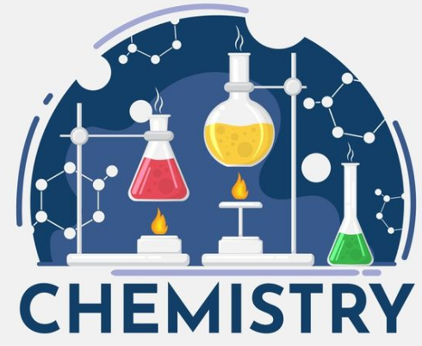
Outline
Reduction and oxidation reaction involve the transfer of electrons
Oxidation numbers
Common redox reactions
Essential Chemistry Chapter 6.1 – 6.3, complete Set 8

Slide 3
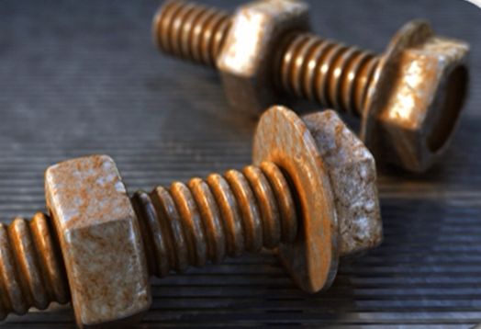
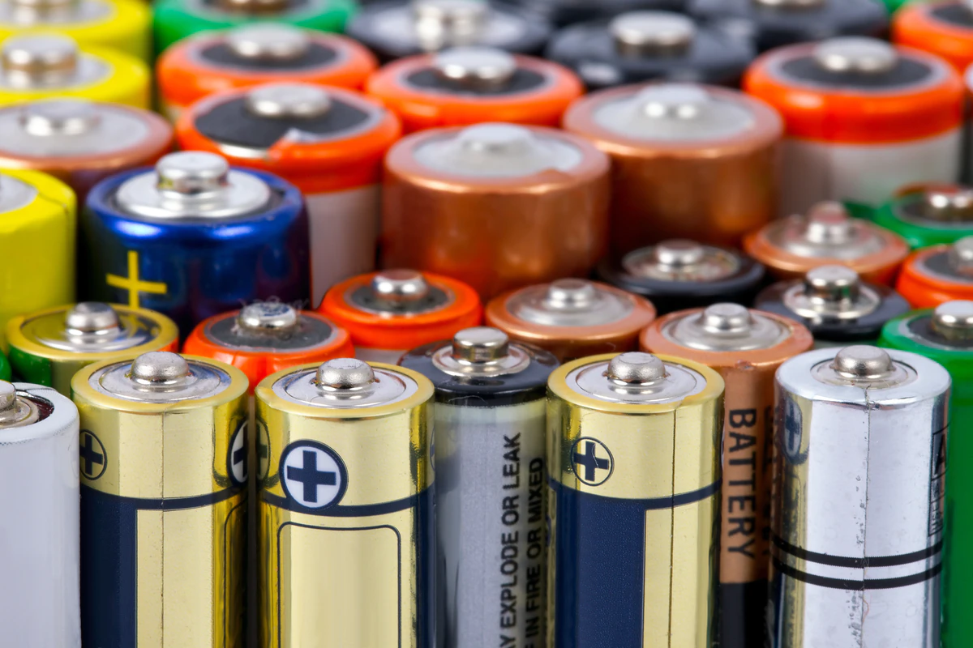

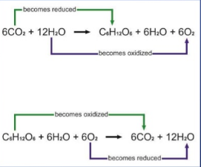
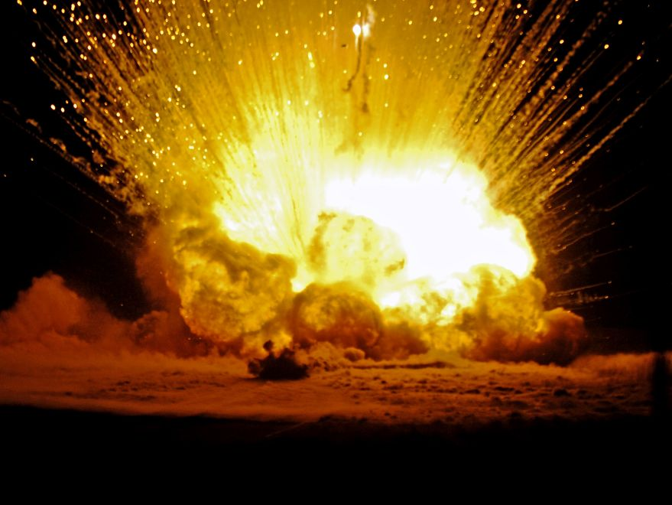

Redox reactions you already know
Iron rusting
Slow
Photosynthesis and cellular respiration
batteries
explosives
Fast

Slide 4
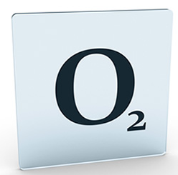
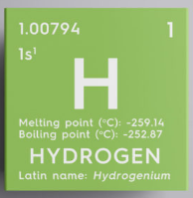
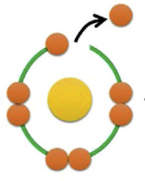
Redox introduction
1. oxidation is a gain of oxygen atoms, reduction is a loss of oxygen atoms
2. oxidation is a loss of hydrogen atoms, reduction is a gain of hydrogen atoms
3. oxidation is a loss of electrons, reduction is a gain of electrons

Slide 5
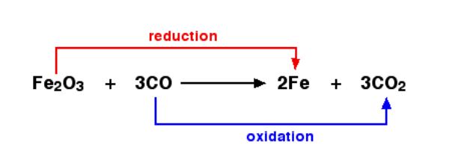
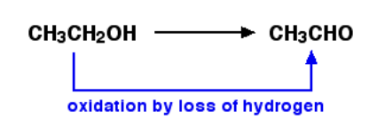
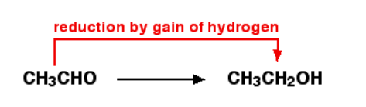
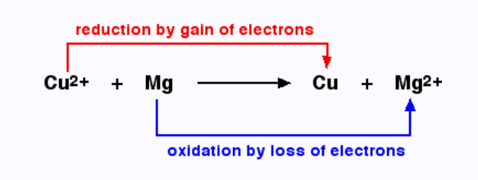
Redox introduction
Here the Cu²⁺ ions gains two electrons forming a Cu atom
Mg atom loses two electrons forming Mg²⁺ ions

Slide 6
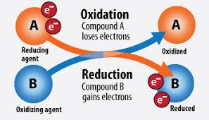
Redox introduction
In a redox reaction some substances lose electrons and others gain electrons. It is a transfer, you cannot have one without the other.
Oxidation – is the loss of an electron
Reduction – is the gain of an electron

Slide 7
Redox introduction
OIL
Oxidation Is Loss of electrons
A is oxidised by B
A loses electrons
A is a reducing agent
A increases in oxidation number
RIG
Reduction Is Gain of electrons
B is reduced by A
B gains electrons
B is a oxidising agent
B decreases in oxidation number

Slide 8
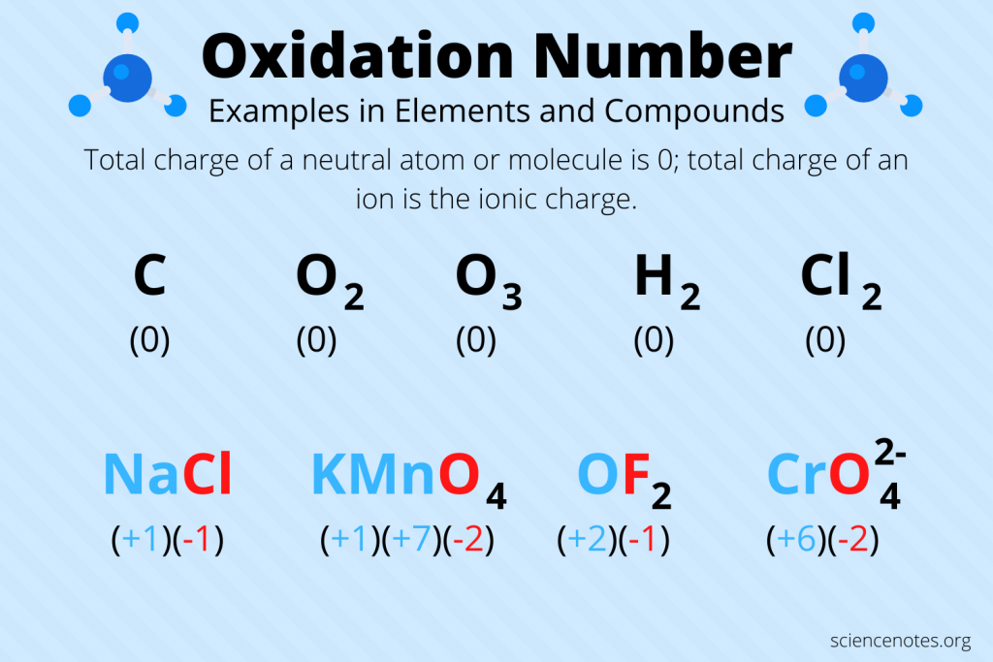
Oxidation numbers
Oxidation numbers are used to track the transfer of electrons in a reaction
Oxidation numbers – the charge the atom would have if the bond was purely ionic
The more positive the number therefor the more electrons the substance has lost

Slide 9
Oxidation numbers
Assigning oxidation numbers
The oxidation state of an uncombined element is zero.
The sum of the oxidation states of all the atoms or ions in a neutral compound is zero.
The sum of the oxidation states of all the atoms in an ion is equal to the charge on the ion.
The more electronegative element in a substance is assigned a negative oxidation state.

Slide 10
Assigning Oxidation numbers
The oxidation state of an uncombined element is zero. That is the oxidation number of atoms of a pure element is zero.
Examples:
Species | H₂ | O₂ | Na | Zn
Oxidation Number | 0 | 0 | 0 | 0
Monatomic ions have an oxidation number equal to their charge.
Species | Zn²⁺ | Al³⁺ | Br⁻ | N³⁻
Oxidation Number | +2 | +3 | -1 | -3

Slide 11
Assigning Oxidation numbers
Element | Usual Oxidation State in a compound | Exception
Group 1 metals | Always +1 | None
Group 2 metals | Always +2 | None
Oxygen | Usually -2 | Peroxides and F₂O
Hydrogen | Usually +1 | Metal hydrides
Fluorine | Always -1 | None
Chlorine | Usually -1 | Compounds with O or F

Slide 12
Assigning Oxidation numbers
The sum of the oxidation states of all the atoms in a neutral compound is zero.
Example: What is the ON of C in Carbon dioxide , CO₂
Since the carbon dioxide molecule is neutral the sum of ON = 0
There are 2 oxygens each having an ON of -2
We can set up an equation: C + (2 X-2) = 0
Solving the equation the ON of C here = +4

Slide 13
Assigning Oxidation numbers
The sum of the oxidation states of all the atoms in an ion is equal to the charge on the ion.
Example: Find the oxidation state of C in C₂H₃O₂⁻
we know that the sum of OS for this compound is -1 (ion charge)
Hydrogen in a compound is +1. Three Hydrogen, +1 x 3 = +3
we know that Oxygen in a compound is -2. Since we have two oxygen, -2 x 2 = -4
With this information, set up an equation
2C+(+3)+(−4)=−1
Solving for C gives its ON as 0.

Slide 14
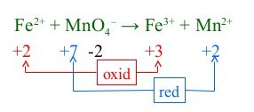
Oxidation numbers
Iron O.N. +2 to +3 Increased O.N. → oxidation
Manganese O.N. +7 to +2 Decrease in O.N → reduction
Oxidation involves an increase in oxidation state
Reduction involves a decrease in oxidation state

Slide 15
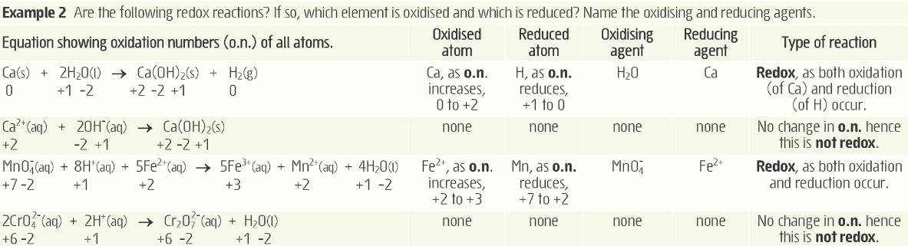
Oxidation numbers

Slide 16
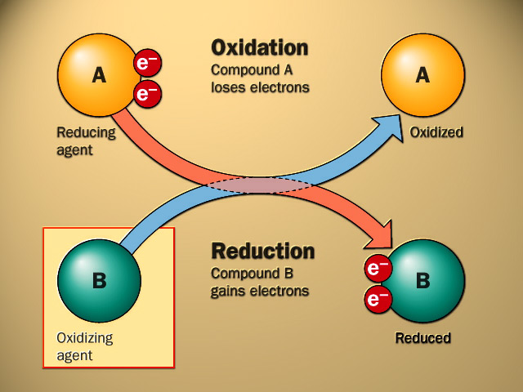
Terminology

Slide 17
Common Redox reactions
Metal-metal ion displacement – Experiment 19
E.g. Cu_{(s)} + 2Ag⁺_{(aq)} → 2Ag_{(s)} + Cu²⁺_{(aq)}
Halogen-halide displacement – Experiment 20
E.g. 2Br ⁻_{(aq)} + Cl_{2 (aq)} → 2Cl⁻_{(aq)} + Br_{2 (aq)}
Combustion – the fuel is oxidised and oxygen is reduced
E.g. 2C₂H₆ _{(g)} + 7O_{2 (g)} → 4CO₂ _{(g)} + 6H₂O _{(g)}
Corrosion – the metal is oxidised and oxygen is reduced
E.g 2Fe_{(s)} + O_{2 (g)} + 2H₂O _{(l)} → 2Fe(OH)_{2 (s)}

Slide 18
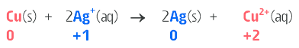
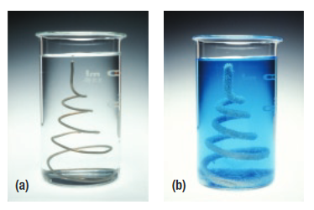
Common Redox reactions
Metal-metal ion displacement
Electron transfer from one metal element to the metal ion of a less reactive metal
More reactive metal becomes oxidized as it loses an electron to the aqueous metal cation, which is reduced and forms a solid metallic precipitate.
Observations:
Before – salmon pink metal in a colourless solution
After – white/silvery precipitate and a blue solution

Slide 19
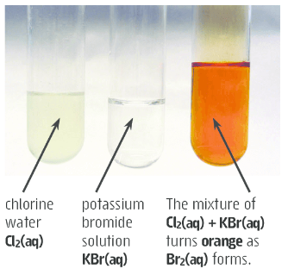
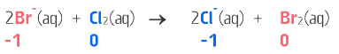
Common Redox reactions
Halogen-halide displacement
Electron transfer to a halogen from the halide ion of a less reactive halogen
More reactive halogen (ie one higher up in group 17) becomes reduced as it gains electrons to form negatively charged aqueous halide ion. The less reactive becomes oxidised (lose electrons) and form elemental halogen.

Slide 20
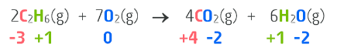
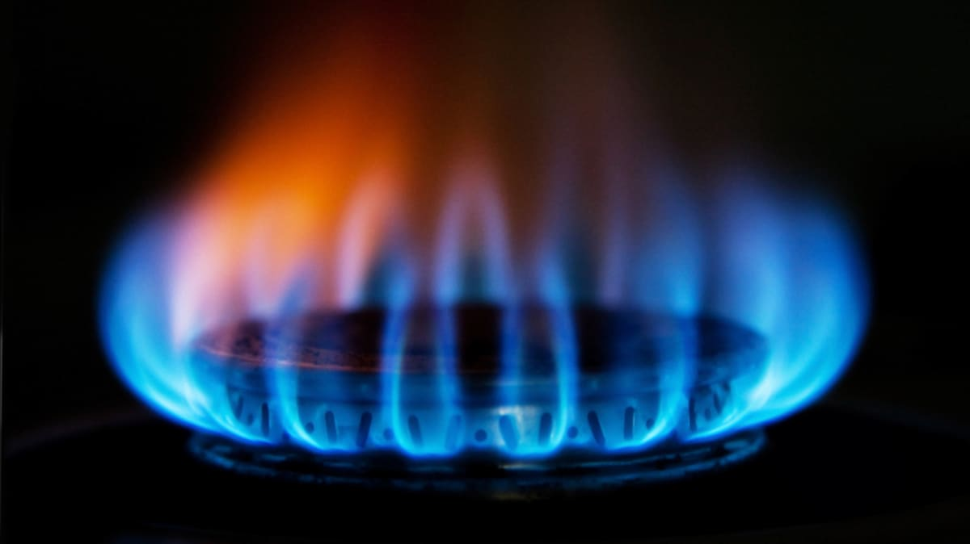
Common Redox reactions
Combustion
Combustion reactions involve the oxidation of a fuel (e.g. wood, hydrogen gas, methane, petrol, coal) and the reduction of oxygen gas

Slide 21
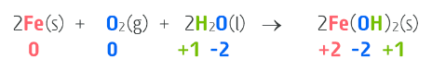
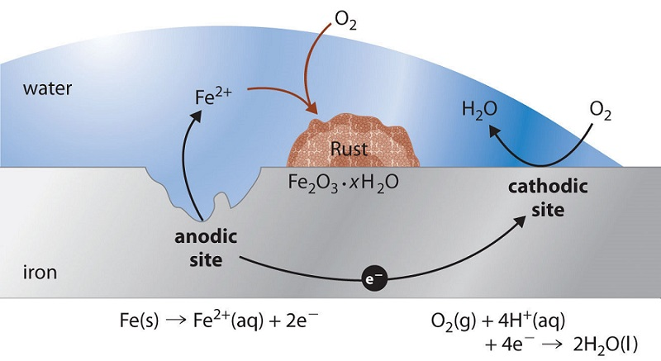
Common Redox reactions
Corrosion
Corrosion of metals (e.g. iron, aluminium, zinc) in the presence of agents like water and oxygen
Water is required for the reaction but it is oxygen gas that is the oxidising agent. Dissolved salts can accelerate corrosion (e.g. sea water)
More reactive metals (like Na, Ca, Mg, Fe) show a greater tendency to corrode than those of lower reactivity (Cu, Ag, Pt, Au)
Al, Cr and Zn form a thin oxide coating that inhibits corrosion

Slide 22
On-going work
Essential chemistry Set 8
STAWA Set 18 – oxidation number
Start preparing for Experiment 19

